Slide 1

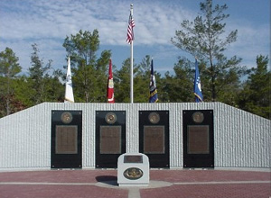
EOD Team Leader Certification Preparation
Notes:
Instructor Notes:
-Begin with introduction of instructor (name, rank, brief bio on EOD career to establish legitimacy)
-Introduce First Sergeant for motivational speech (attention getter)(2 minutes)

Slide 2

Introduction
Course Overview
This instructional unit is comprised of two 1-hour blocks of instruction on EODTLC preparation for new EOD Soldiers. The first session includes an introduction, lecture on EODTLC process with supporting instructional material, and a live demonstration of EOD Team Leader response techniques during a practical explosive incident. Learners will then be provided the opportunity to practice these skills over the next week, with the mentorship of their assigned EOD Team Leaders, in preparation for session two.
Session two will include a practical application session for learners to demonstrate their skills with feedback and a written assessment to assess learner knowledge. Following the written assessment, learners, mentors, and unit facilitators will conduct a debrief session to cover all lessons learned, share thoughts from reflective journaling, provide unit feedback, and conduct a brief question and answer session.
Notes:
-Have class read slide and highlight important information.

Slide 3
Introduction
Course Timeline
Session One
(1 Hour)
Practice
(1 Week)
Session Two
(30 minutes)
Debrief
(30 minutes)
Brief EVENT descriptions:
Introduction
EODTLC process lecture
EOD TL incident response demonstration
Practice of knowledge, skills, and attitudes with oversight and feedback from EOD Team Leader
Reflective journaling
Practical application of EODTL response techniques with feedback.
Written assessment
Sharing of lessons learned and reflections from journaling
Instructor observational feedback
Q&A
Notes:
-Cover timeline and expand upon each session, highlight events.

Slide 4
Introduction
Learning Objectives
The learning objectives for this unit of instruction are that, upon completion of instructional activities, learners will be able to:
Describe and explain the role of an EOD Team Leader during comprehensive EOD operations.
Identify the appropriate equipment required to conduct full-spectrum EOD operations.
Demonstrate the proficiencies required to receive and respond to EOD incidents 100% of the time.
Notes:
-Explain LOs and how instruction will support them.

Slide 5

Introduction
Learner Expectations
Professionalism
Promptness
Engagement
Acceptance of constructive criticism
Reflective Journaling
Honesty in Self-Assessment
Notes:
-Elaborate on the professional/personal competencies required of learners.

Slide 6
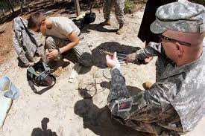
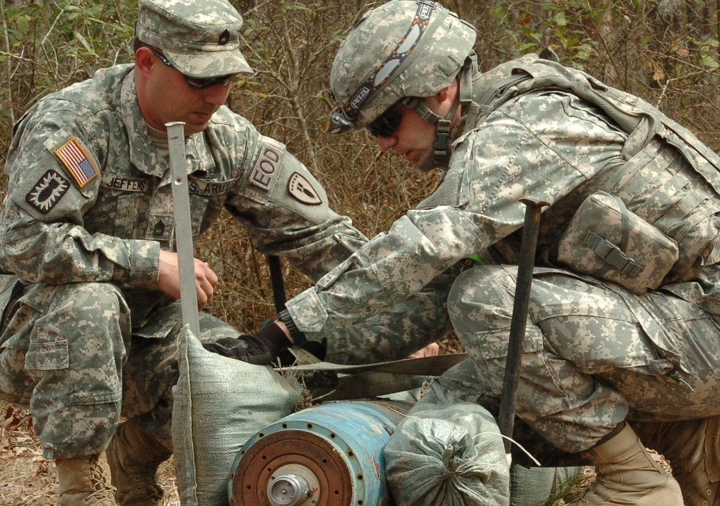
EOD Team Leader Certification
Begins upon assignment to operational EOD organization.
Culminates with certification as EOD Team Leader.
1-3 years
74 assessed tasks
3 real-world EOD response missions
21 assigned readings
Notes:
-Explain briefly what learners can expect when selected for EODTLC integration.

Slide 7
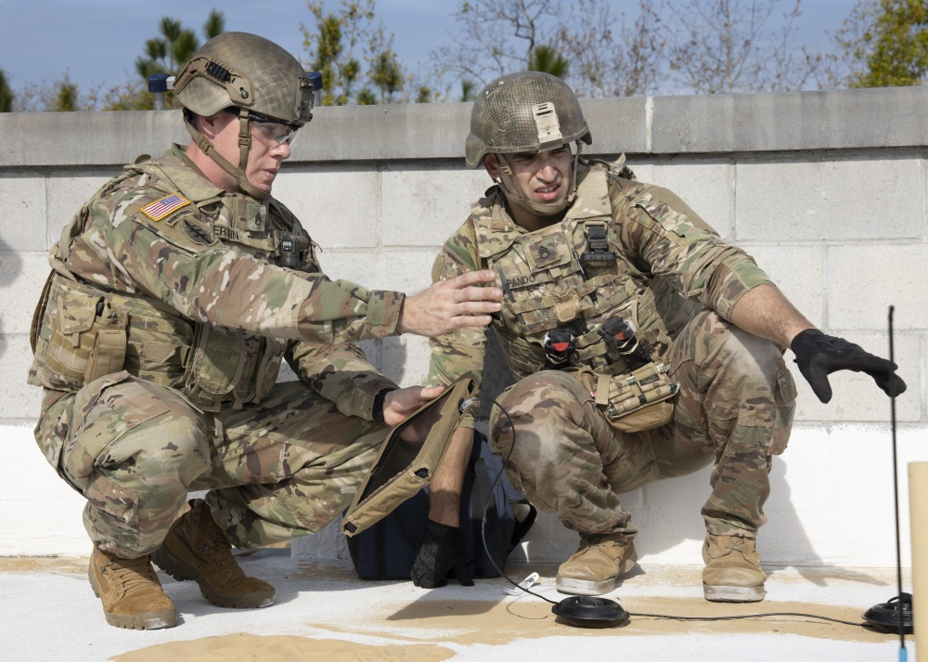
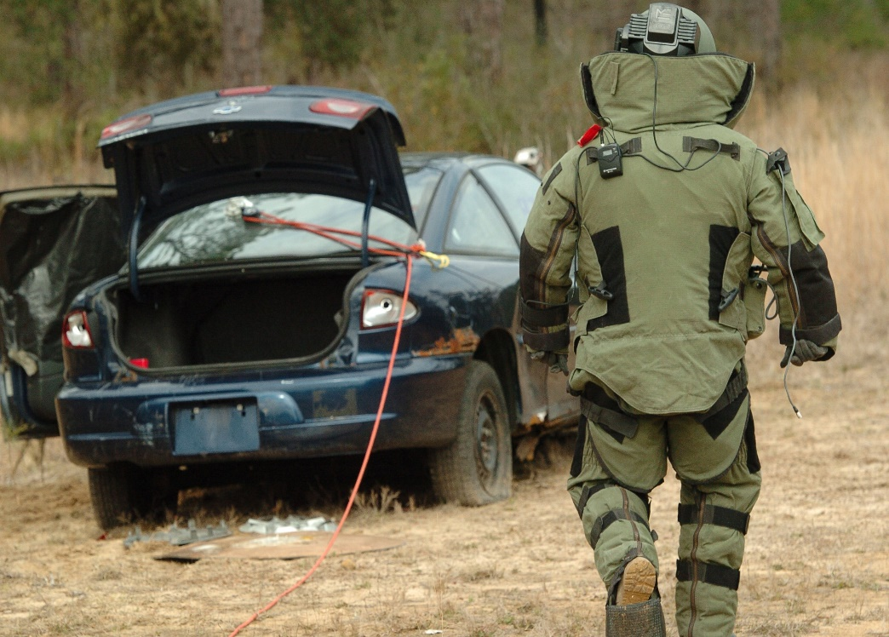
EOD Team Leader Attributes
Professional
Subject-Matter Expert
Fully Responsible for Life, Safety, and Protection of Property on Scene
Team LEADER
Notes:
-Explain what it means to you to be an EOD team Leader, flesh out slide with personal references and experiences.

Slide 8
Incident Notification
Professional communications and phone etiquette
NOTIFICATION AUTHORITY CONTACT INFORMATION
Utilization of EOD/UXO Nine-Line Report
Line 1. Date time group discovered:
Command policy will dictate local or Zulu time.
Line 2. Reporting activity location:
Mandatory 8-digit grid (include landmarks, reference points, cross streets, or street addresses)
Line 3. Contact method:
Radio frequency, call sign, telephone number.
Line 4. Type of ammunition:
Dropped, projected, placed, thrown, or improvised.
Line 5. NBC contamination:
Yes or No known NBC contamination. If yes, report type of agent if known or identified.
Line 6. Resources threatened:
What resources? Are they critical?
Line 7. Impact on mission:
How is UXO/device impacting regular operations?
Line 8. Protective measures taken:
What has been done to mitigate damage or injury? (Evacuation, barricading, etc.)
Line 9. Recommended priority:
Immediate, indirect, minor, or no threat.
60 MINUTES OR LESS
Notes:
-Elaborate on importance of initial notification phone call and telephonic professionalism.
-Heavily emphasize importance of Notification Authority contact information in case of call drop or disconnect.
-Allow class to explain the lines of the UXO Nine-Line, correct and guide as needed.
-Emphasize timelines, must depart no later than 60 minutes after they hang up with Notification Authority.

Slide 9
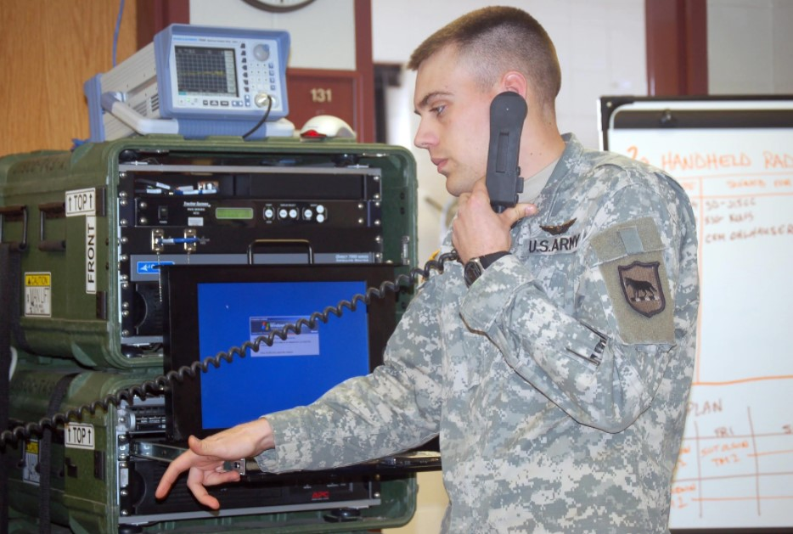
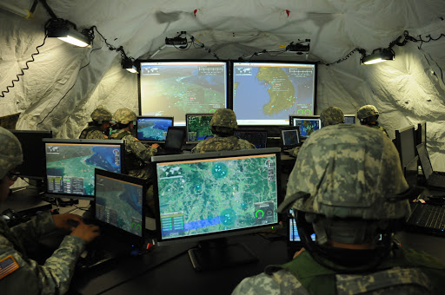
Incident Notification
Team Member notification
Back-up Team Member procedures
EOC NOTIFICATION (required for installation departure)
Notes:
-Explain notification protocols
-Activate NAVSCOLEOD knowledge on incident reporting.
-Heavily emphasize importance of EOC contact and dialogue to ensure no delays in mission departure.

Slide 10
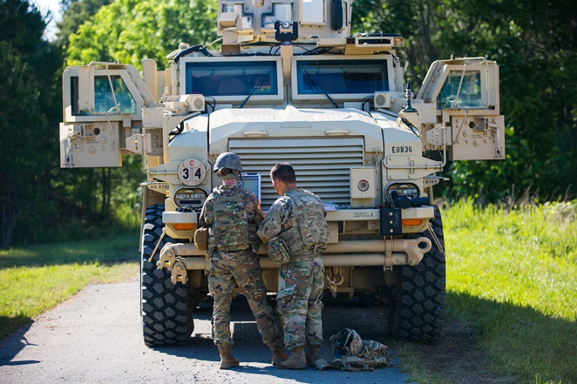
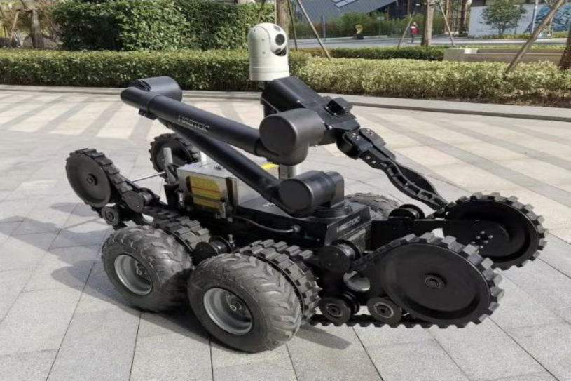
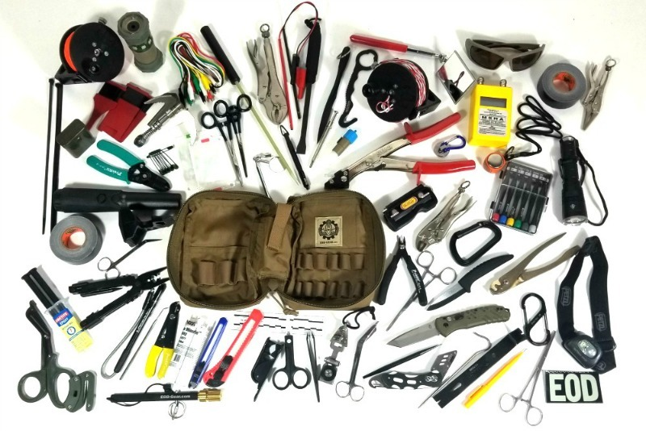

Incident Preparation
Vehicle (PMCS, Fuel, Paperwork)
Equipment (Batteries, Inventory, PPE)
Notes:
Elaborate on importance of vehicle and equipment readiness.
Highlight triple battery stock rule.
Explain how prior preparation will allow more time for redundancy of information (good thing).
Provide personal examples.

Slide 11
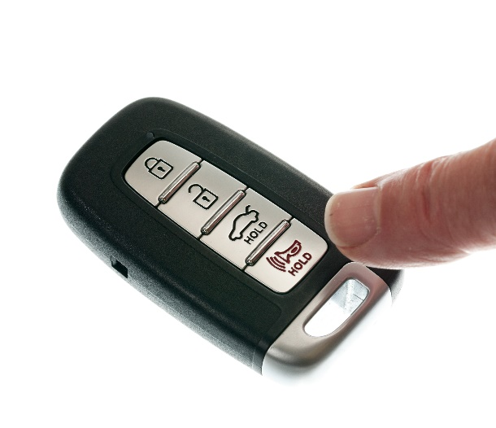


Departure to Incident
Incident Log
Vehicle Security
Facility Security
EOC CLEARANCE
Duty Officer Notification
Notes:
-Close out with departure procedures.
-Elaborate on all topics, but heavily emphasize EOC clearance.

